Slide 1

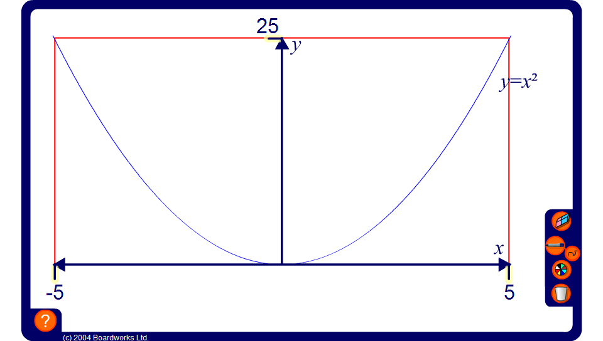


Squares and square roots from a graph
Notes:
Explain to pupils that if we plot numbers against their squares we get a graph of the shape shown on the board. This shape is called a parabola.
Ask pupils to give you the coordinates of some of the points that will lie on this curve. For example, (2, 4), (–3, 9) or (1.5, 2.25).
Drag the red line along the y-axis to show how we can use the graph to find both the positive and negative square roots of the numbers on the y-axis. Point out that most of these numbers have been rounded to two decimal places. Unless a number can be made by multiplying or dividing square numbers, its square root cannot be written as an exact number.
By dragging the the red line along the x-axis, show how we can use the graph to find the squares of given numbers on the y-axis. The squares of these numbers are exact.

